Slide 1

PHRED Problem Notification and Corrective Action System
Supplier Training
June 2020

Slide 2

PHRED Solutions
What is PHRED
PHRED is a web-based Problem Notification and Corrective Action System
  Note: Works best in Chrome browser
JELD-WEN utilizes this system for notifying suppliers:
  Problem with product or services
  Requesting RMA (Returned Material Authorization) e.g. credit
  Issuing Corrective Actions
PHRED – IS NOT AN ACRONYM FOR ANY QUALITY MEANING.
IT IS SIMPLY THE NAME OF THE SOLUTION PROVIDER

Slide 3
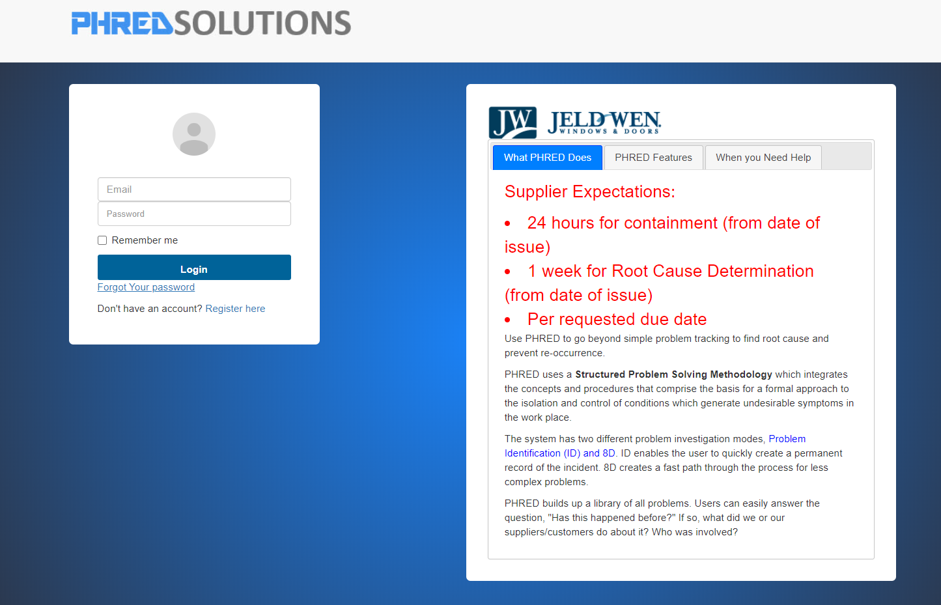
User Registration
JELD-WEN Suppliers must register
Users that will respond issue must be registered as users of PHRED
Typical users:
  Customer Service
  Quality
  Sales Representatives
  Plant Managers
https://www.PHRED.co/jeldwen/Home/Login.cfm?Hrez=1280&VRez=720

Slide 4
Supplier Responsibilities
Suppliers Must:
Promptly respond to any PHRED Notification and Corrective Actions (8D)
Disposition RMA Request
    Credits must be issued within 7 days of notification
  Respond to Corrective Actions by the due date
    Provide containment information within 24-48 hours
  Suppliers may attach internal Corrective Action formats so long as they meet an A3 or 8D approach
    Suppliers must still address all required fields by adding text such as “See attached A3” so that program can save and allow you to submit your response

Slide 5

Using PHRED
Let’s get started
https://www.PHRED.co/jeldwen/Home/Login.cfm?Hrez=1280&VRez=720
For easy access bookmark the site address to your browser

Slide 6
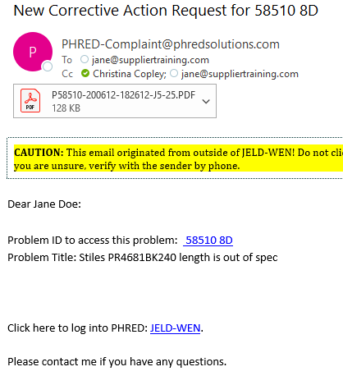
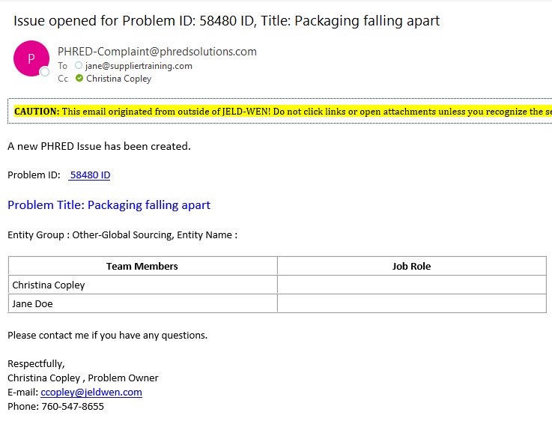
PHRED E-Mail Notifications
PHRED E-Mail Notifications
E-mail examples
PHRED will send out email notifications to the supplier contact when:
  A problem has been entered
  An action item was assigned
  Or an 8D – Corrective Action was issued
Hyperlink to PHRED
Make sure PHRED e-mail do not go into your spam box

Slide 7
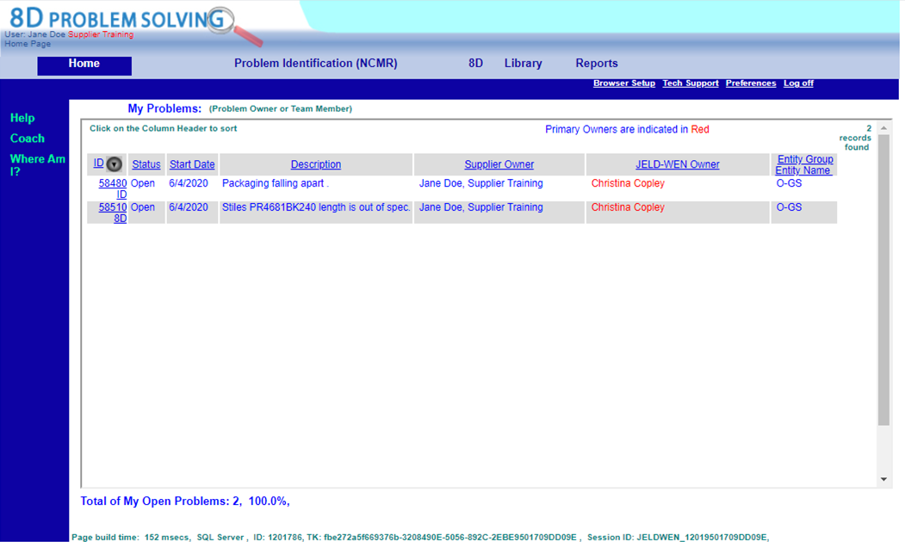
PHRED
Home Screen
Home Screen – My Problems
This page is your "to do" list.
  Only problems that are assigned to you (as Problem Owner or Team Member) are displayed on the home screen
Columns may be sorted by clicking on column header
Columns may be sorted by clicking on column header
Hyperlink to problem
Click on the Problem ID. It will open it
ID: Problem Notification
8D: Corrective Action required
*Both require supplier response

Slide 8
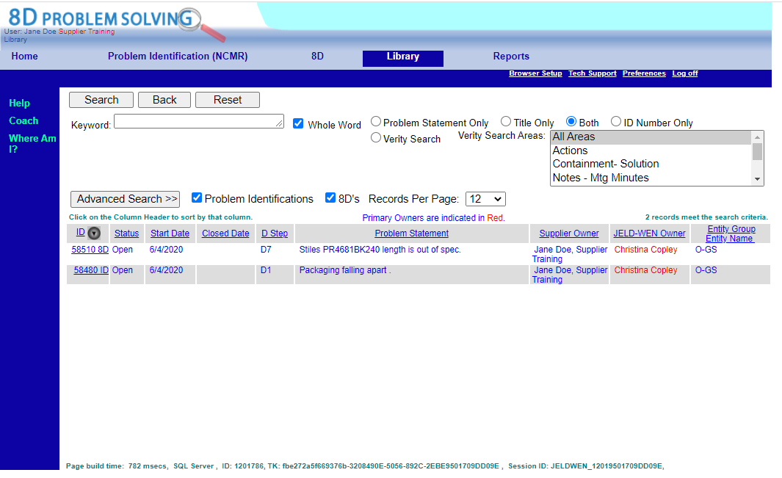
Library
Search feature
Library Tab
Use the Library tab conduct searches
  Search features work like all known search functions
    Note: The same sorting and hyperlink features can be used within this tab
Hyperlink to problem
Click on the Problem ID (ID). It will open the problem for you to work on it

Slide 9
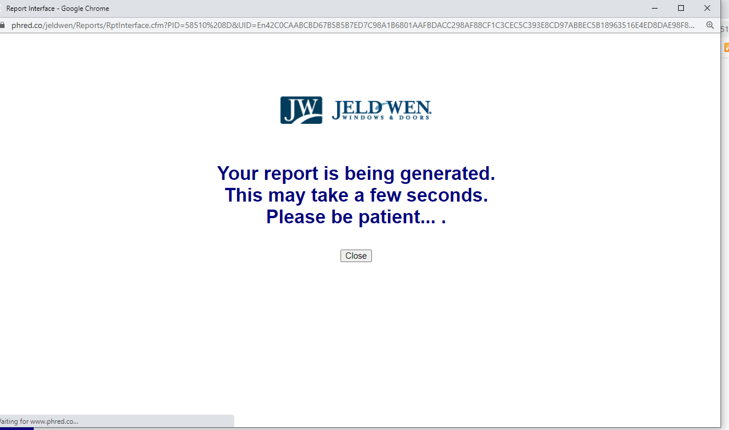
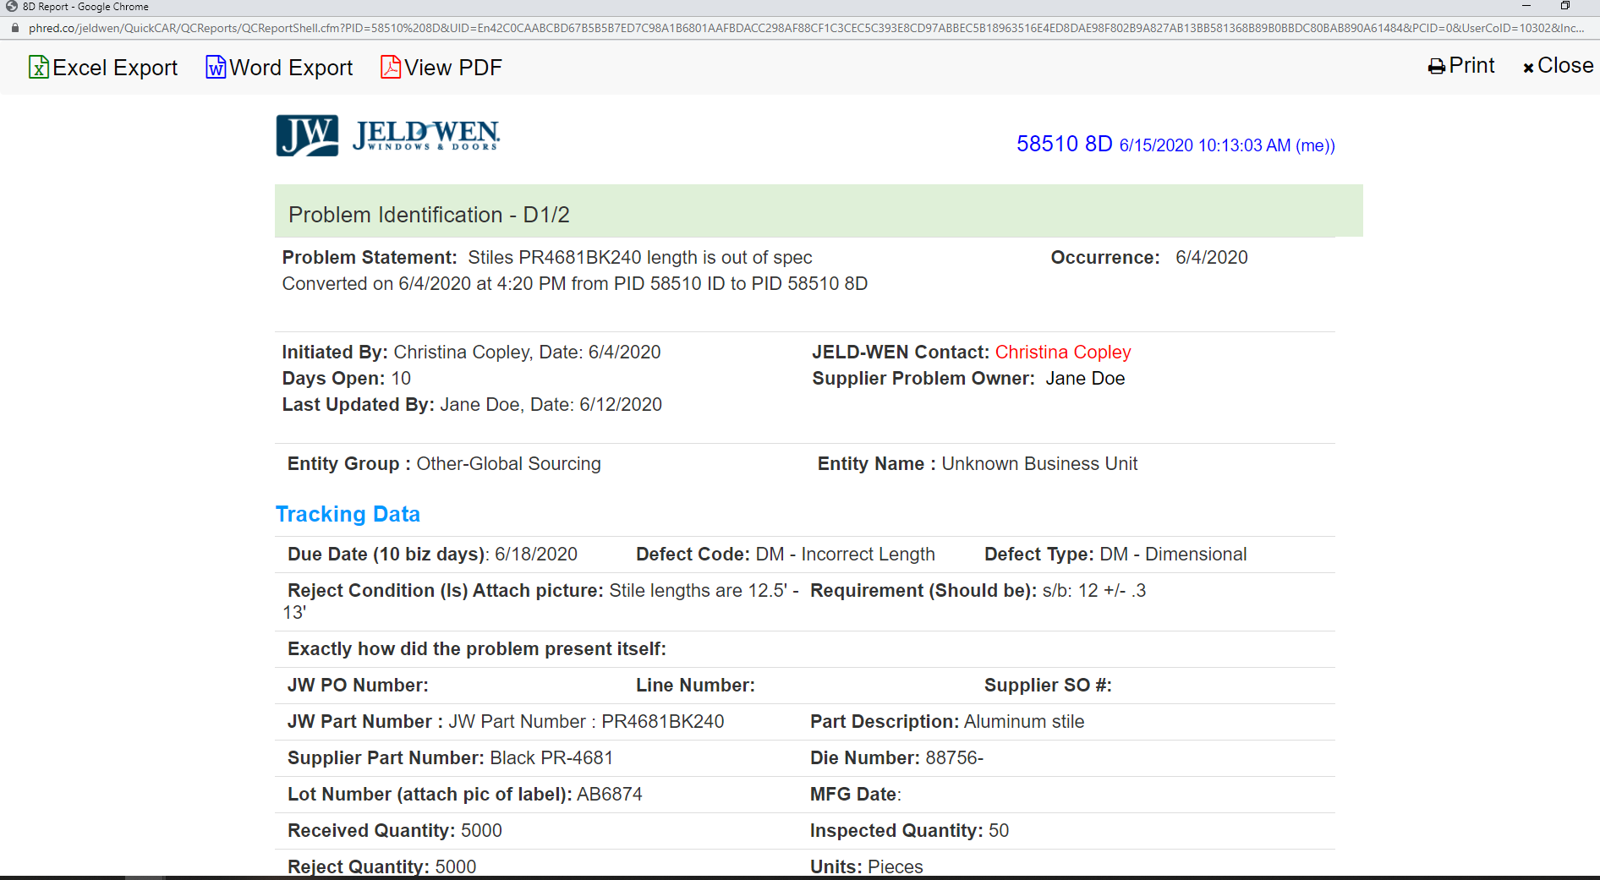
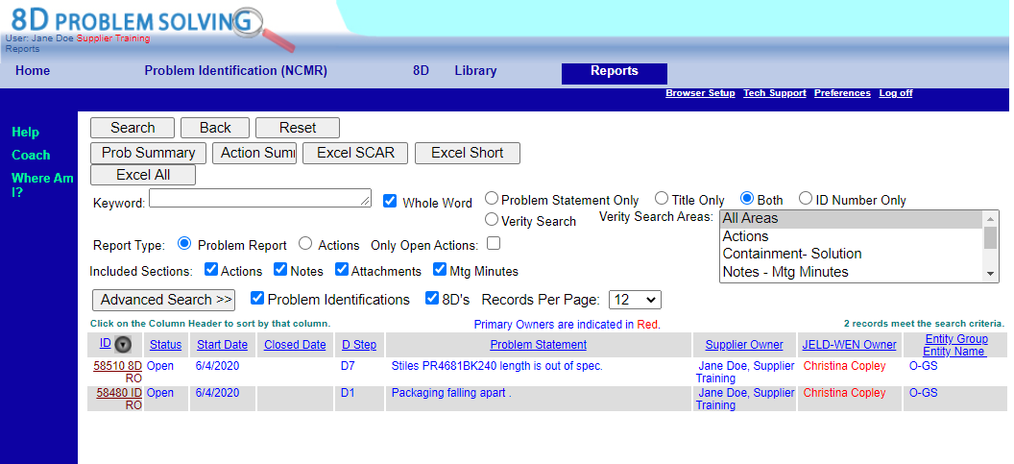
Reports
Report Tab
This section is not to be used when you want to update/edit.
This page is only to be used to view or save in a report format
To view a specific Problem Report
  Click the ID number that you want to view
  The report appears in a pop-up window
  To save/export the report
  Select the format and (right click) to save
Select format method
To save report (right click, save as)

Slide 10
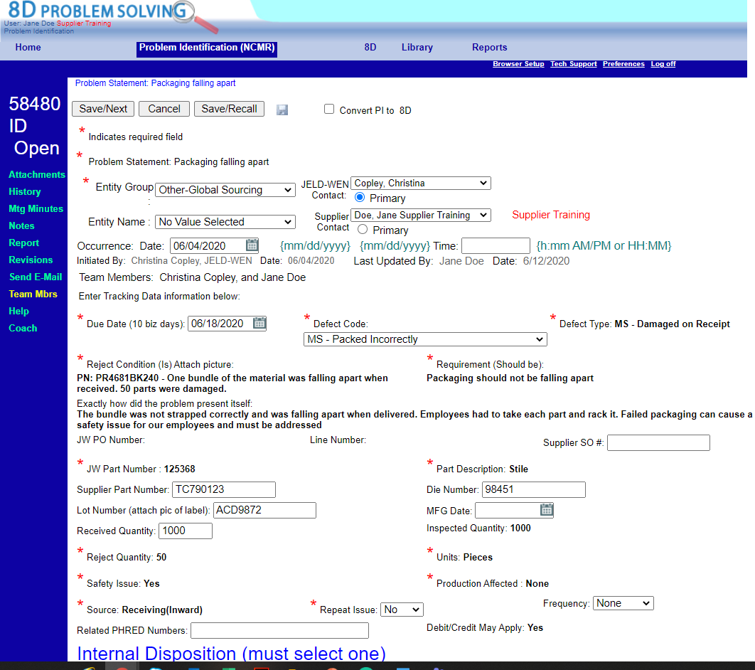
Helpful Hints
Saving
  Required fields
  You must enter data in the required fields, designated by a red *asterisk, in order to save
  Save/Next
  Saves the information that you have entered and moves you to your Home Screen
  Save/Recall
  Saves the information that you have entered and keeps you in the screen you are currently in

Slide 11
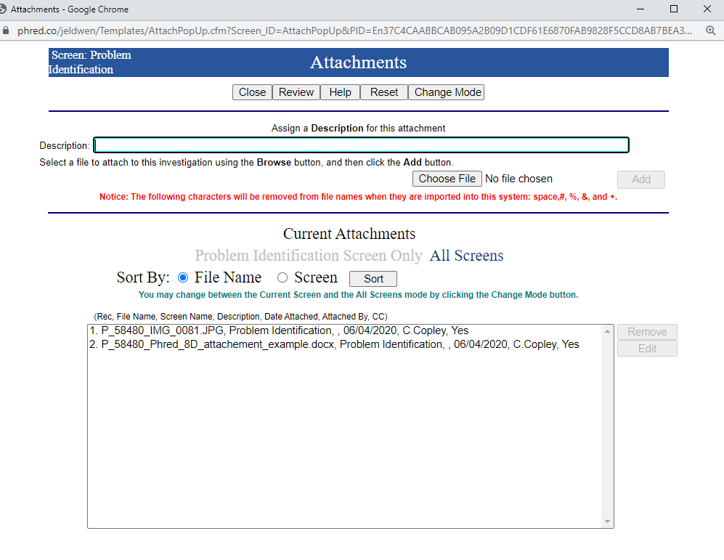
Helpful Hints
Attachments
  To attach reference files to the specific problem
    Click Attachments from the links on the left of the screen
    Pop-up window will appear “Attachments”
    Works like all attachment functions
    Choose file
    Click “Add”
      If attached correctly, file will appear in box
    Click “Close”
*Attachments Note: You can only attach in this section. To view JELD-WEN provided attachments go to reports tab

Slide 12
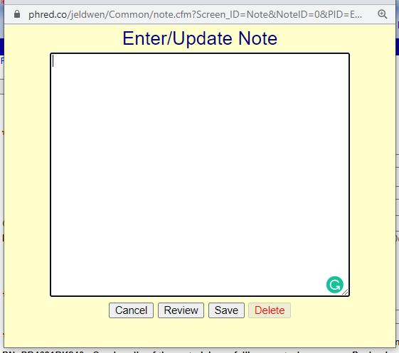
Helpful Hints
Notes
  To add a note to the specific problem
    Click “Notes” from the links on the left of the screen
    Pop-up window will appear “Notes”
    Enter note
    Click save
*Note: there is also “Notes/Comments” section within the Problem ID in the “To be completed by Supplier section

Slide 13
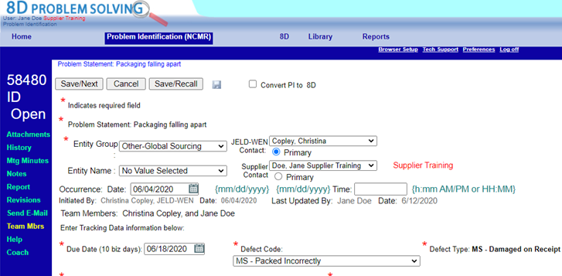
Helpful Hints
Specific Problem Report
“Report” Hyperlink on left side of the screen
  Note: This feature will only generate a report for the problem you are currently in
  This report is only to be used to view or save the report
To view the Problem Report
  Click “Reports” from the links on the left of the screen
  The report appears in a pop-up window
Select format method
To save report (right click, save as)

Slide 14
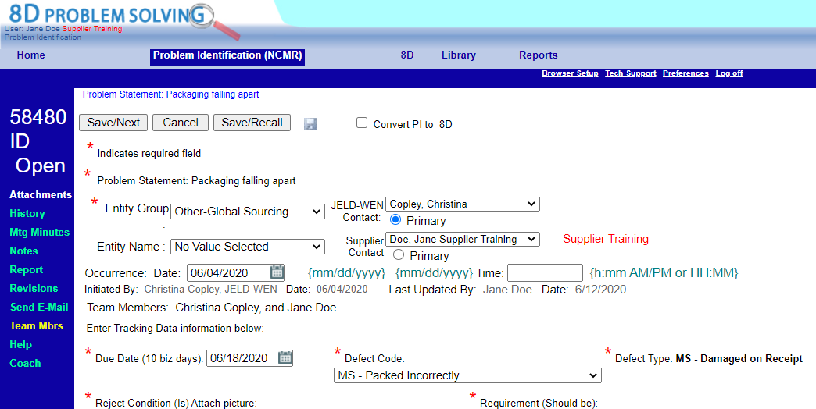
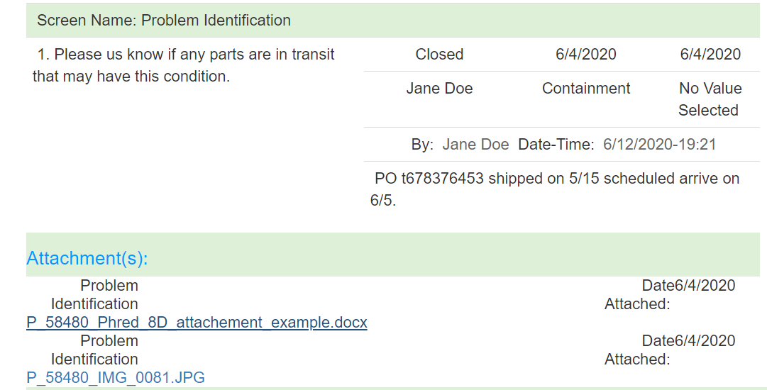
JELD-WEN Provided Attachments
View Attachments
  Generate the Specific Problem Report
  Attachment Hyperlinks are located at the bottom of the report
  Click on the attachment Hyperlink to open the attachment
  Note: Attachments are only available within the specific Problem Report

Slide 15

UPDATING PHRED
Problem IDs

Slide 16
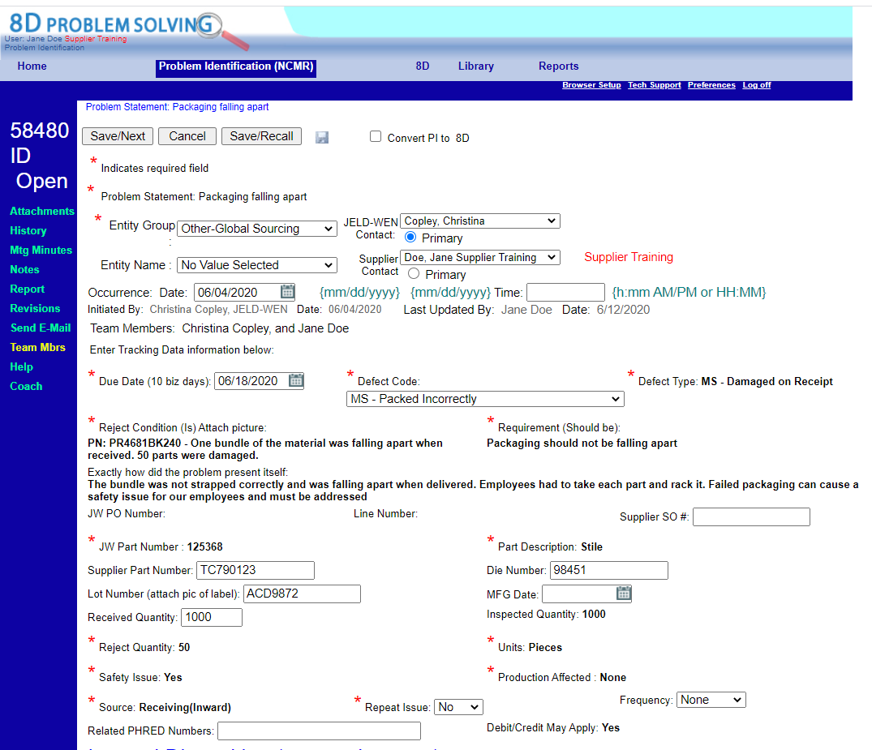
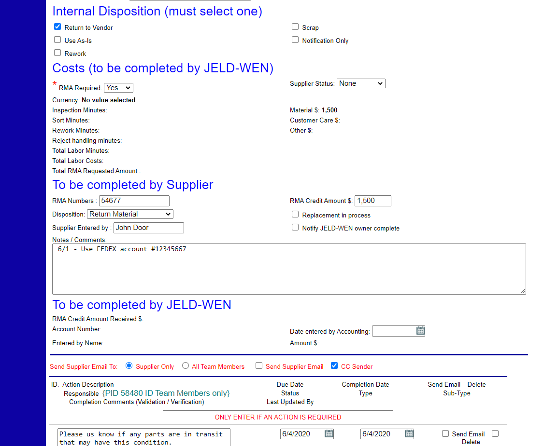
Problem IDs
Problem ID Notification
Click on Hyperlink to Problem
Review Problem Information:
  Review within Problem or generate Report
    Generation of report is recommended so that you can obtain the attachments
  JELD-WENs Disposition
      Return to Vendor
      Use As-Is
      Rework
      Scrap
      Notification only (required supplier acknowledge the notification)
  Costs
    This section will communicate the RMA requested amount
Note: All Problems require the Supplier to respond

Slide 17
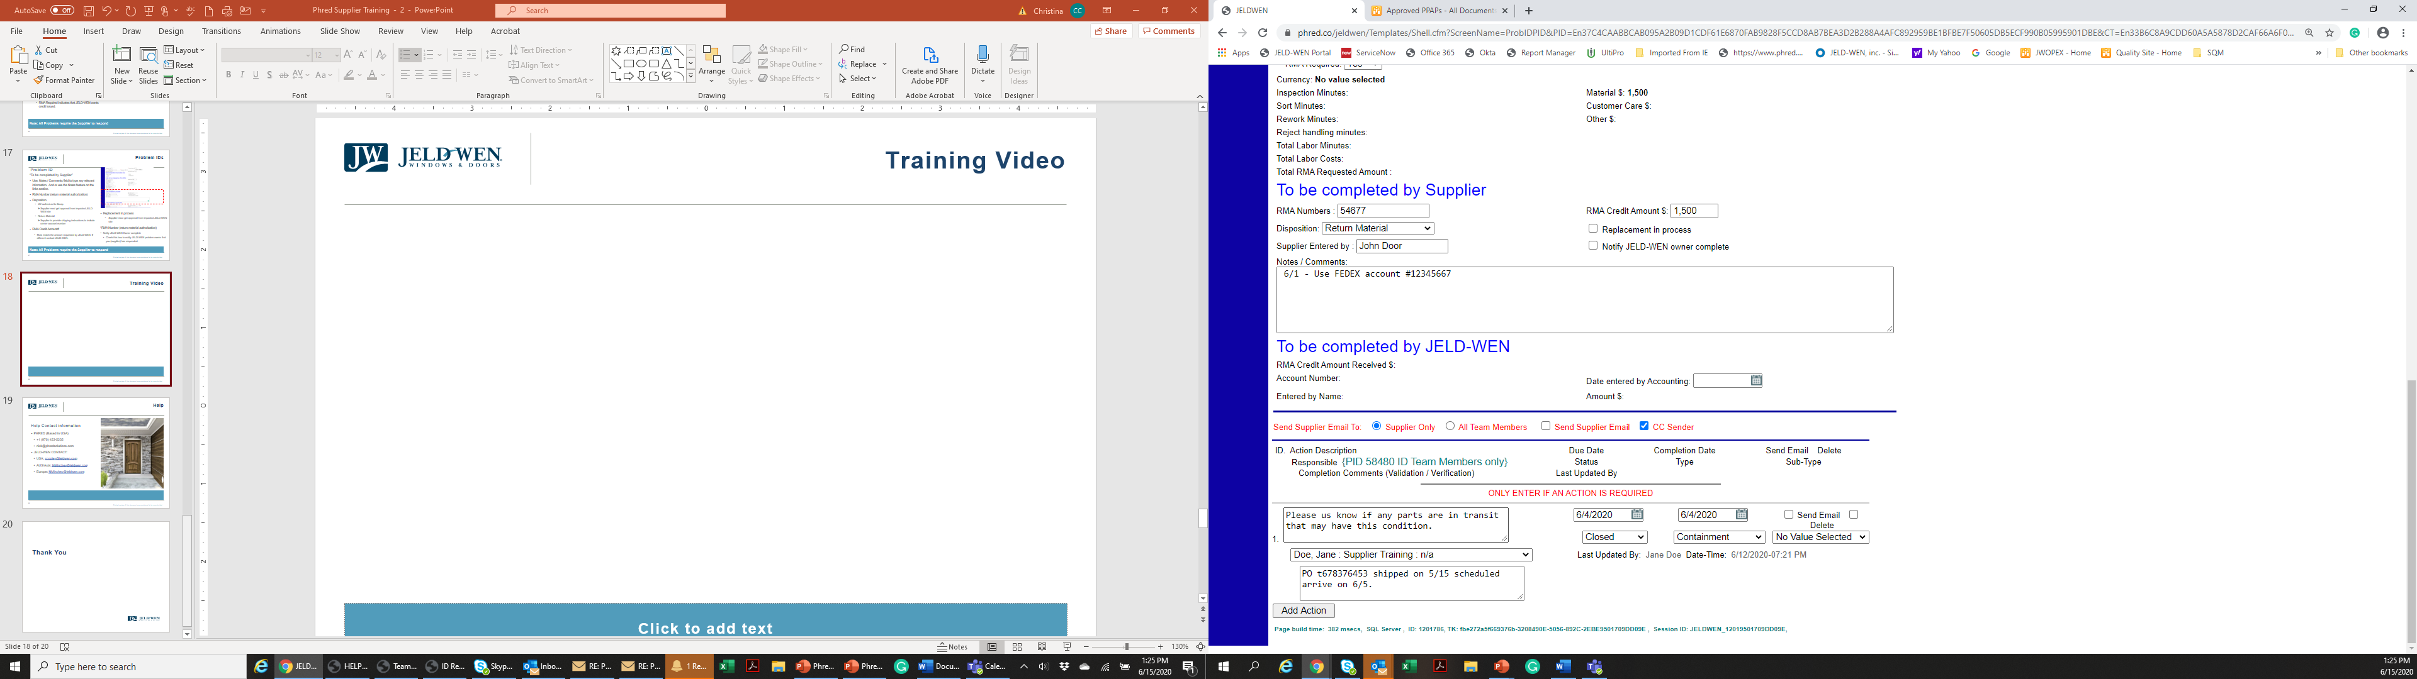
Problem IDs
To be completed by Supplier
Respond to Problem ID
  Update Applicable fields
    RMA (return material authorization) Number:
      Enter RMA or Credit Memo Number
    Disposition:
      JW authorized to Scrap
        Supplier must get approval from impacted JELD-WEN site
    Return Material
        Supplier to provide shipping instructions to include carrier account number in the Notes/Comments box
      Problem Acknowledged
        To be used when an RMA is not required
    RMA Credit Amount$
      Enter the amount of the issued RMA.
        Must match the amount requested by JELD-WEN. If different contact JELD-WEN
    Replacement in process
    Supplier must get approval from impacted JELD-WEN

Slide 18
Problem IDs
To be completed by Supplier
Respond to Problem ID
Use: Notes / Comments field to type any relevant information.
Enter the name of Supplier user that entered the information.
Notify JELD-WEN Owner complete
  Check this box to notify JELD-WEN problem owner that you (supplier) has responded.
  Click “Save/Next” or “Save Recall”

Slide 19
Problem IDs
To be completed by Supplier
Problem ID
Action items:
  Problem Notifications my have action items assigned
  Action items must be addressed
    Respond
    Update status
    Add date completed
    Save/Recall
    Click “Send email”
    Save
4. Remember to “Save/ Recall”
1. Respond to Action
2. Update Action status
3. Add Date Completed
5 .Click “Send Email” to notify JELD-WEN Problem owner
Note: All action items must be addressed in order to close the problem

Slide 20
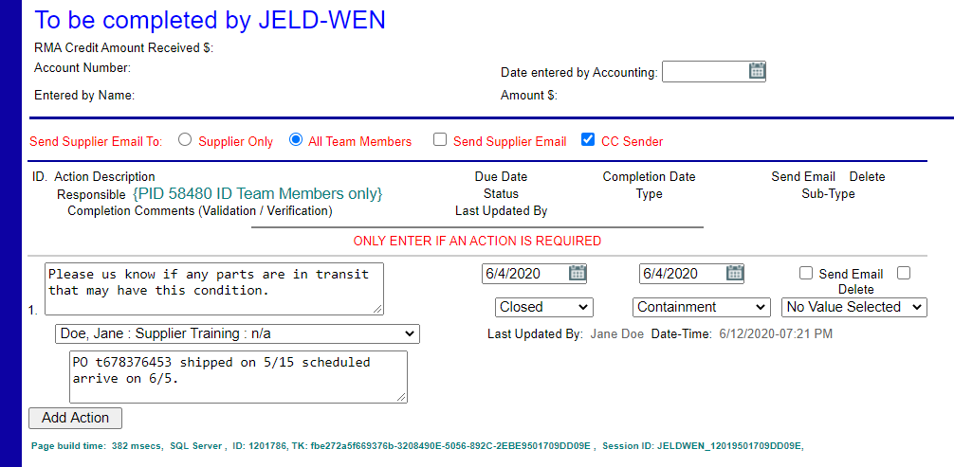
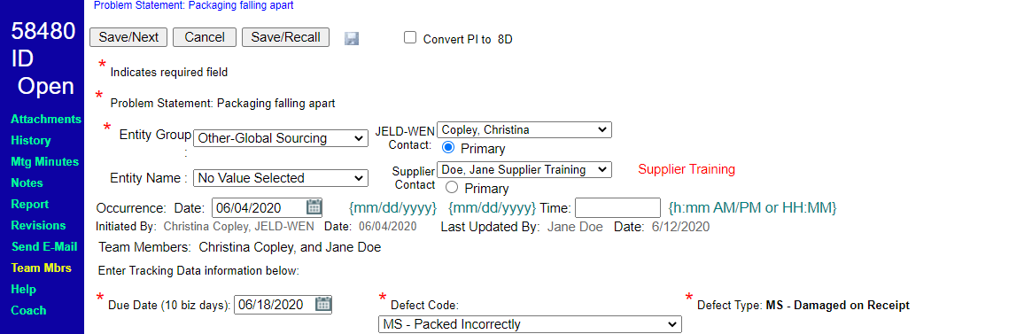
Problem IDs
Ready for JELD-WEN Review
Ready for JELD-WEN Review
    Save Recall
    In the Send Supplier Email to section:
    Select “Send to all team Members”
    Save/Recall
    Click “Send email”
    PHRED System will send email to all team members, including JELD-WEN
    Save
Click “Send Email” to all team members
Save/Next to leave Problem

Slide 21

UPDATING PHRED
8D (Corrective Action)

Slide 22
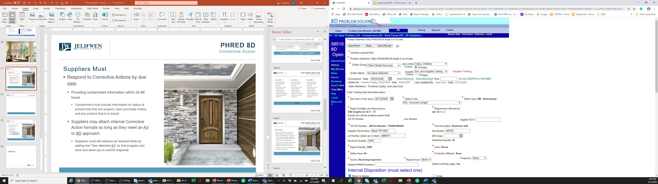
PHRED 8D
Corrective Action
Suppliers Must
  Respond to Corrective Actions by due date
  Providing containment information within 24-48 hours
      Containment plan must include information on status of product lots that are suspect, open purchase orders, and any product that is in transit and interim actions taken such as: 100% inspection etc.
  Suppliers may attach internal Corrective Action formats so long as they meet an A3 or 8D approach
      Suppliers must still address all required fields by adding text “See attached A3” so that program can save and allow you to submit response

Slide 23
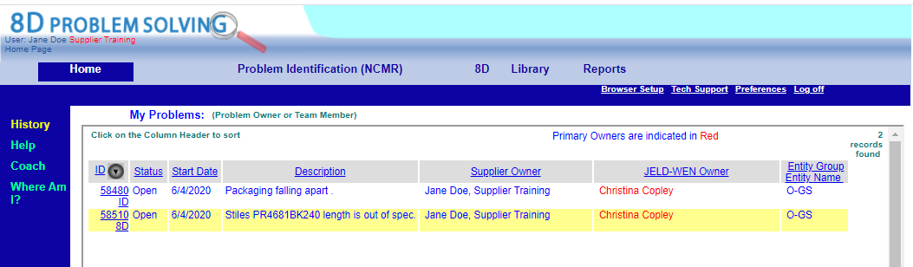
PHRED 8D
Corrective Action
Instruction
  Home Screen: Select the 8D
  Now in 8D Tab (steps D1-2)
      *D1-D2 is the Problem Identification screen but is now part of the 8D – Corrective action
  Review information and attachments as instructed in Problem Identification section

Slide 24
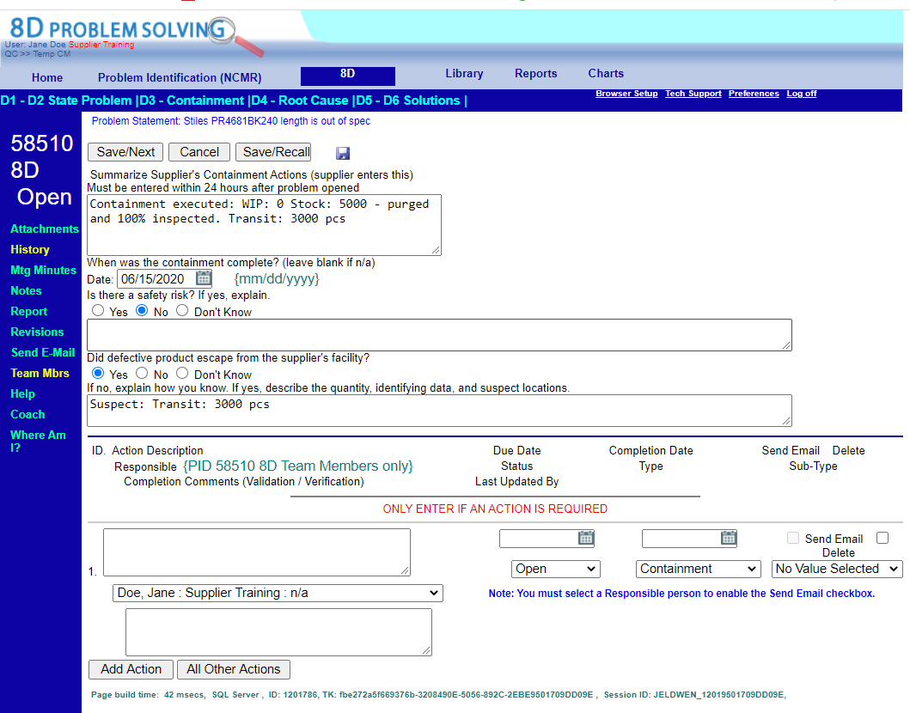
PHRED 8D
Corrective Action
Containment
  4. Click on D3 - Containment
  Containment: immediate actions taken to address the symptoms of a detected nonconformity and isolate the problem. *mitigate all risk of nonconforming product getting to JELD-WEN
  Examples:
    Identify all suspect product (WIP: work in process, Stock, Identify product in transit and promptly communicate to JELD-WEN) and taking actions such as: 100% inspection/sorting etc.
  5. Complete containment fields all Fields
  6. Address any assigned action items
  7. Save/Recall
Click on “D3 - Containment”
Address any assigned action items
Containment is a band-aid to stop the bleeding

Slide 25
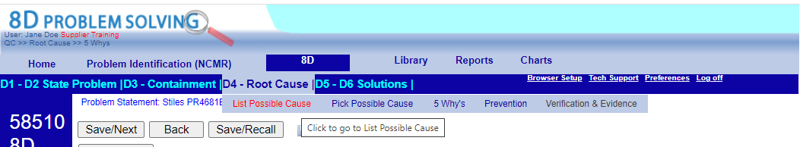
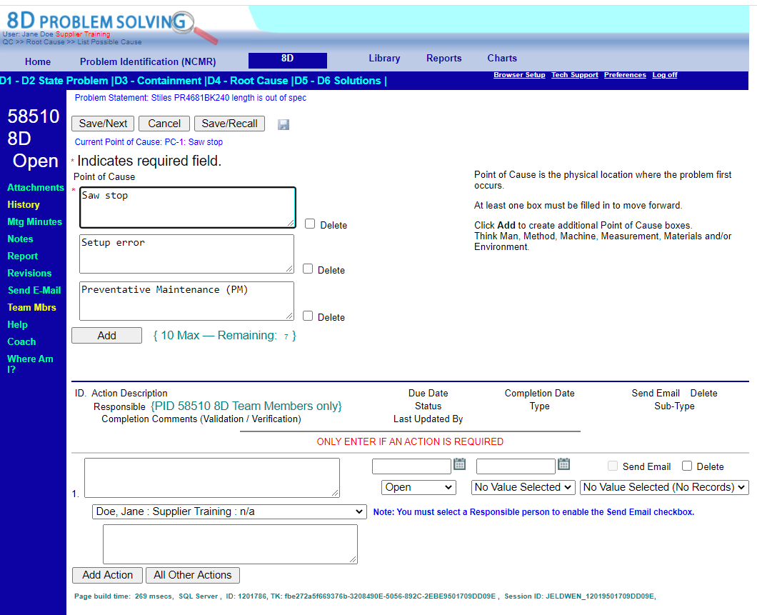
PHRED 8D
Corrective Action
D4 - Root Cause
  8. Click on D4 - Root Cause/List of possible cause
  9. Identify possible causes
    You must enter at least one Possible Cause in order to continue in the Root Cause section
      Identifying possible causes is essential because as it helps the team think outside any biased causes
      10. Click “Save/Next” to move to next step
      or click Save/Recall and select “Pick Possible Causes” from the header
Click Add if you have more causes you want note
You can’t fix the problem if you don’t know the true root cause of the problem

Slide 26
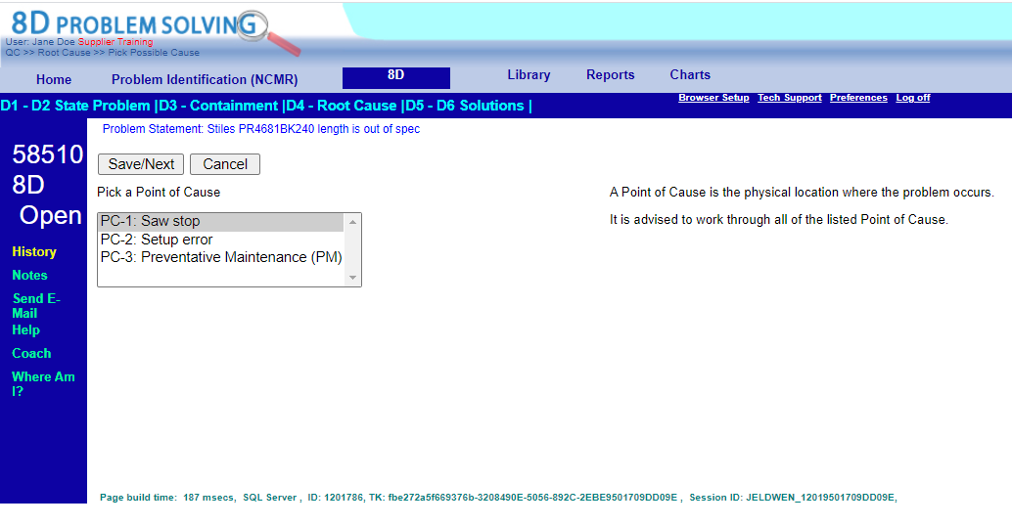
PHRED 8D
Corrective Action
D4 - Root Cause
  11. Pick a Point of Cause
  This exercise helps the team explore all possible causes
      12. Click “Save/Next” to move to next step
      or click Save/Recall and select “5-Why’s” from the header
You can’t fix the problem if you don’t know the true root cause of the problem

Slide 27
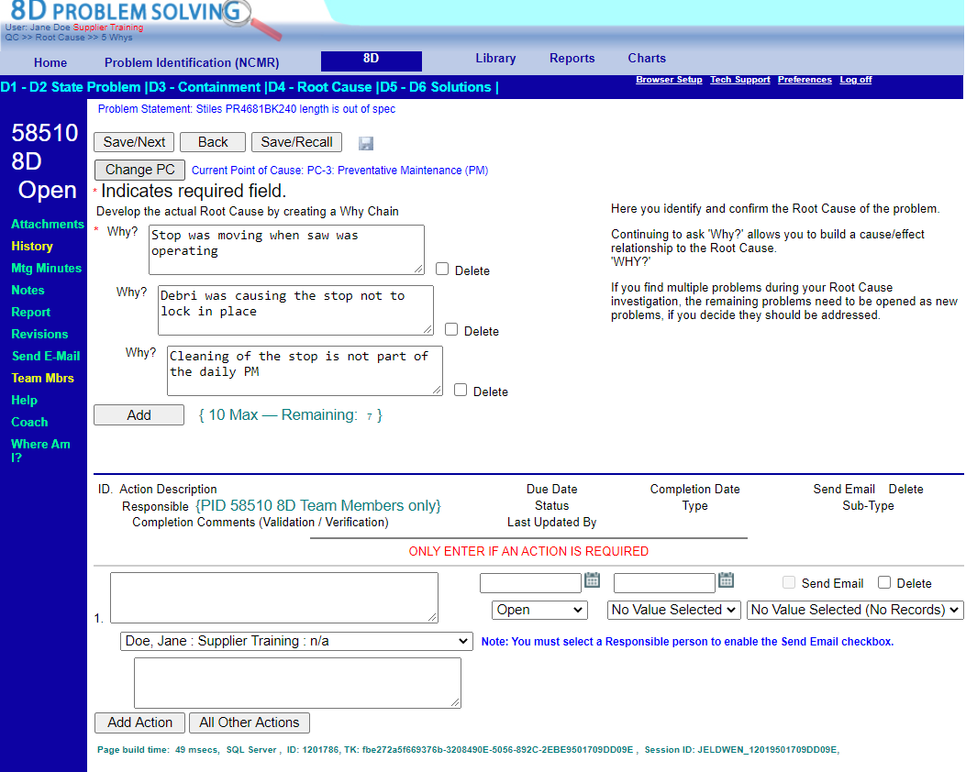
PHRED 8D
Corrective Action
D4 - Root Cause
  13. 5-Why exercise
  This exercise helps the team identify the root cause of the problem
      14. Click “Save/Next” to move to next step
      or click Save/Recall and select “Prevention” from the header
You can’t fix anything if you don’t know the true root cause of the problem

Slide 28
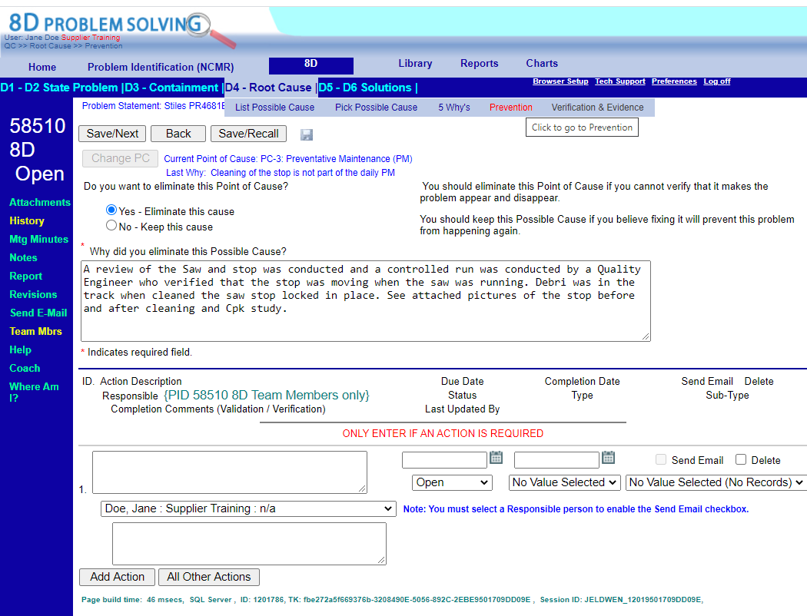
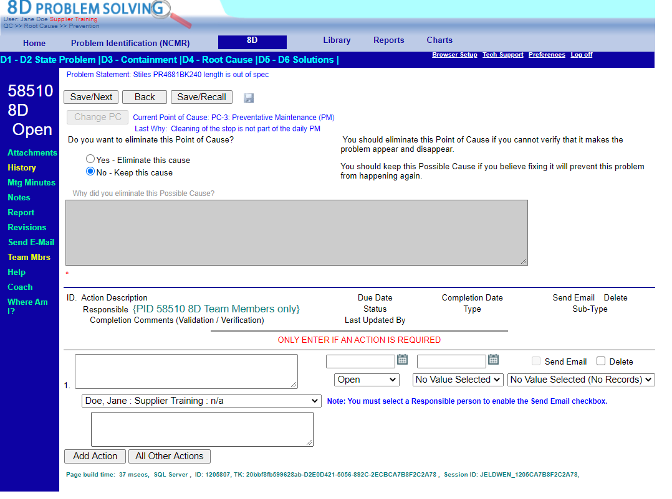
PHRED 8D
Corrective Action
D4 - Root Cause
  Root Cause/Prevention
  15. Identify or eliminate the cause
      Eliminate cause
        If eliminate a cause, you must provide reason, or the system will not let you save
        Click Save/Recall and continue with exercise until you select the cause
      If you have identified the cause move to the next screen
      16. Click “Save/Next” to move to next step
      or click Save/Recall and select next “Verification & Evidence” from header
Eliminate a Point of Cause
*must provide reason if eliminating a cause
Click “Keep a Point of Cause” if this is the identified cause
You can’t fix the problem if you don’t know the true root cause of the problem

Slide 29
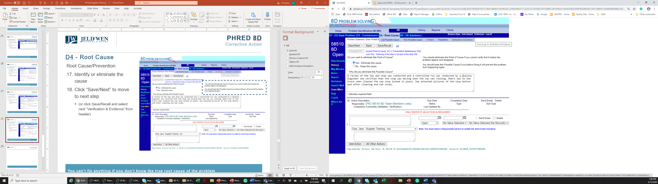
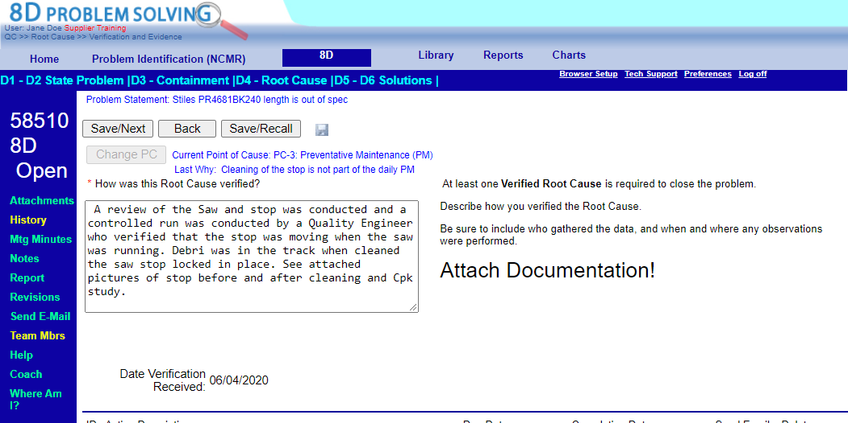
PHRED 8D
Corrective Action
D4 - Root Cause
  Root Cause/Verification & Evidence
  17. Document how the root cause was verified
      18. Attach supporting evidence
      19. Click “Save/Next” to move to next step
      or click Save/Recall and select next “D5-D6 Solutions” from header)
You can’t fix the problem if you don’t know the true root cause of the problem

Slide 30
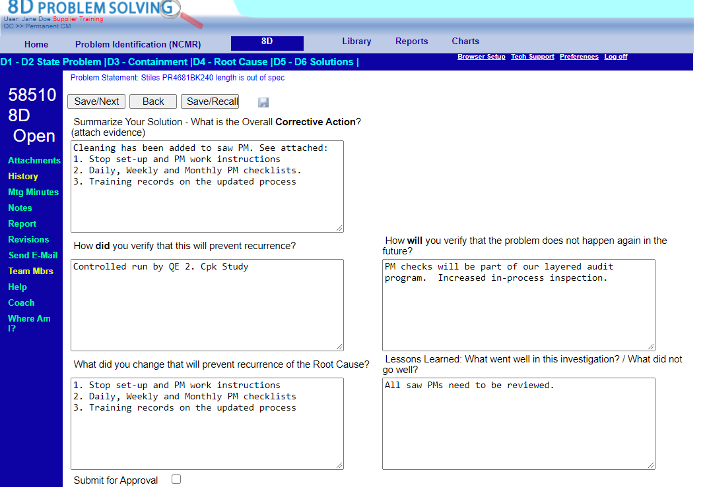
PHRED 8D
Corrective Action
D5 – D6 Solutions
      Identify all of your solutions (Corrective Actions)
      Complete each of the boxes in this section
      Click “Save/Recall

Slide 31
PHRED 8D
Corrective Action
D5 – D6 Solutions
  Submit for Approval
  22. Review work
        Generate Report to review entire problem and your responses
          If you want to edit simply select the section from the header
        If ready submit for (JELD-WEN) approval Proceed to next steps
      23. Check box: Submit for Approval
      24. Save/Next
      25. PHRED will email JELD-WEN problem owner
      26. PHRED and/or JELD-WEN will notify you of closure or problem with response

Slide 32
Help
Help Contact information
PHRED (Based in USA)
  +1 (970) 453-5235
  nick@PHREDsolutions.com
JELD-WEN CONTACT:
  USA: ccopley@jeldwen.com
  AUS/Asia: NMinchev@jeldwen.com
  Europe: NMinchev@jeldwen.com

Slide 33
Training Video

Slide 34
Thank You

